Slide 1
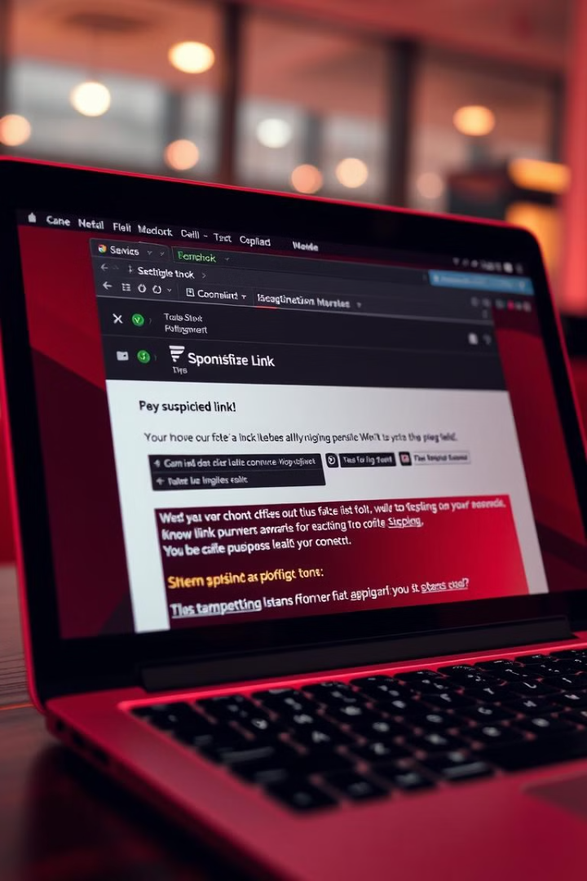
Phishing Awareness Training
This training will cover the fundamentals of phishing and equip you with the knowledge to recognize and avoid these attacks. You will learn to spot phishing emails, websites, and social engineering techniques. The goal is to make you a more secure user, better equipped to protect yourself and our organization from malicious actors.
PM
by Prajwal Mane

Slide 2
What is Phishing?
Definition
Goal
Phishing is a type of social engineering attack. It uses deceptive emails, websites, or messages to trick you into revealing personal or sensitive information.
Phishers aim to steal your passwords, credit card numbers, or other valuable information. They use this information to gain access to your accounts or commit fraud.

Slide 3
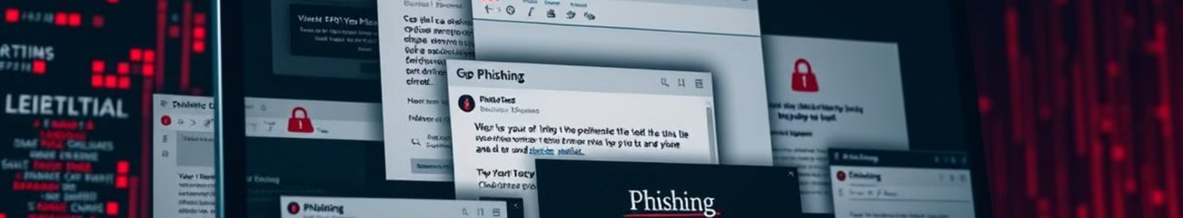
Types of Phishing Attacks
Email Phishing
Website Phishing
Social Engineering
This is the most common type of phishing attack. It uses emails that appear to be from a legitimate source.
Phishers create fake websites that look like legitimate websites, such as banks or online stores.
Phishers use social interaction to gain your trust and obtain your personal information.

Slide 4

How to Spot Phishing Emails
1
Suspicious Sender
2
Urgent Tone
The email address may be misspelled or look slightly different than expected.
Phishing emails often use a sense of urgency to pressure you into acting quickly.
3
Unprofessional Design
4
Suspicious Links
The email may have poor grammar, typos, or inconsistent formatting.
Links in the email may lead to a fake website or a malicious website that downloads malware.

Slide 5




How to Spot Phishing Websites
Website Address
Security Certificate
The website address may look slightly different from the real website address.
The website may not have a valid security certificate, which is indicated by a padlock icon in the browser address bar.
Website Content
The website may have grammatical errors, typos, or inconsistencies in the design or content.

Slide 6

Common Social Engineering Tactics
1
Pretexting
Phishers create a believable story to convince you to give them information.
2
Baiting
They offer you something desirable, such as a free gift or a prize, in exchange for your information.
3
Scare Tactics
They try to scare you into giving them information by claiming that your account is at risk or that you have a virus.

Slide 7





How to Protect Yourself from Phishing
Be Suspicious
Be cautious of emails, websites, and messages that ask for personal information.
Verify Information
Double-check the sender's address, website address, and the information requested.
Use Strong Passwords
Use strong passwords that are difficult to guess.
Update Your Software
Keep your operating system and software up-to-date with the latest security patches.

Slide 8

Key Takeaways & Next Steps
Remember, phishing attacks are becoming increasingly sophisticated. Be vigilant, cautious, and aware of potential threats. If you are unsure about the authenticity of any communication, contact your IT department or the organization in question directly. We encourage you to share this training with your colleagues and continue to learn about phishing and cyber security threats. Stay safe!

